Slide 1
Seam Carving For Content Aware Re-Sizing
Project ID-4
Sandeep Kallepali(20161177)
Siva Abhilash Varma(20161155)
Mentor:-
Siddhartha Gairola

Slide 2
Objective
Seam carving allows a change in size of the image by modifying the least noticeable pixels in an image.

Slide 3
Problem
Statement
By using this method(Seam Carving) we can manipulate with main content of the image.Which was a difficult task to achieve in cropping and scaling where main content manipulation is automated

Slide 4
Motivation
Digital images are often viewed in many display devices with a wide variety of Aspect Ratios . Simple ways of resizing are scaling and cropping.Scaling reduces perceivable details and cropping can’t be done automatically and even if it could there might be loss in data(Information) because cropping alters the image’s composition and is not always desirable.

Slide 5
Overview

Slide 6
What is a SeamCarving
Seam Carving is a technique targeting image resizing based on detection of seams from the energy function of the image. The method aims at finding one pixel wide path from top to bottom or left to right which have minimum energy and manipulating the image using them.

Slide 7
The one pixel wide paths mentioned above are called Seams. Seams can be either vertical or horizontal. A vertical seam is a path of 8 connected pixels from top to bottom in an image with one pixel in each row. A horizontal seam is similar with the exception of the connection being from left to right.
What is a Seam

Slide 8
Pipeline
Given an image for Content Aware Resizing
Calculate the Energy Image of the input
Find the least/Optimal Seams
Perform resizing using the optimal seams

Slide 9
(Gradient Magnitude)- There are various methods to extract the unnoticeable pixel from an image. First and most basic method is to assign energy to each pixel by using a gradient operator.(Sobel, Prewitt, Robert or Laplacian) to compute the gradient in both x and Y direction.
Generally energy function is defined as follows:
e1(I) = |∂/∂x (I)| + |∂/∂y (I)|
Gradient Function

Slide 10
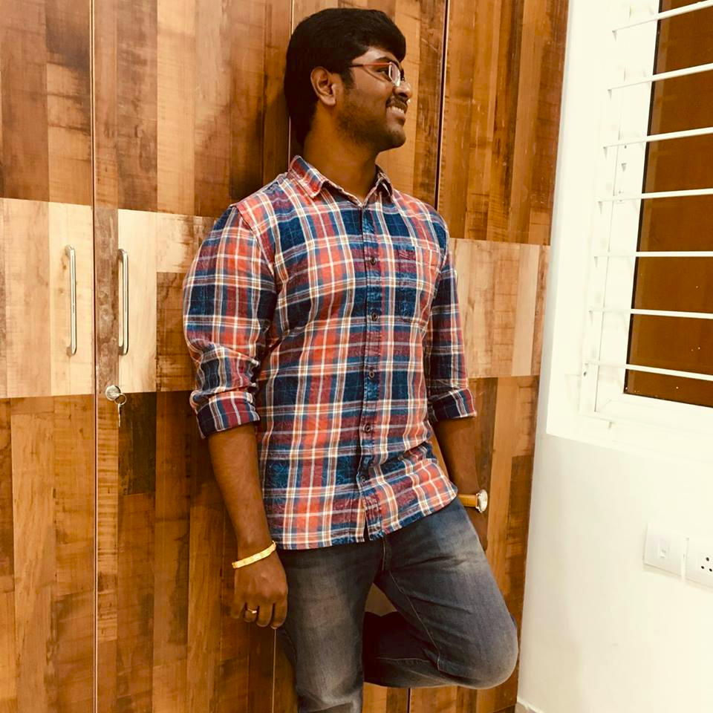
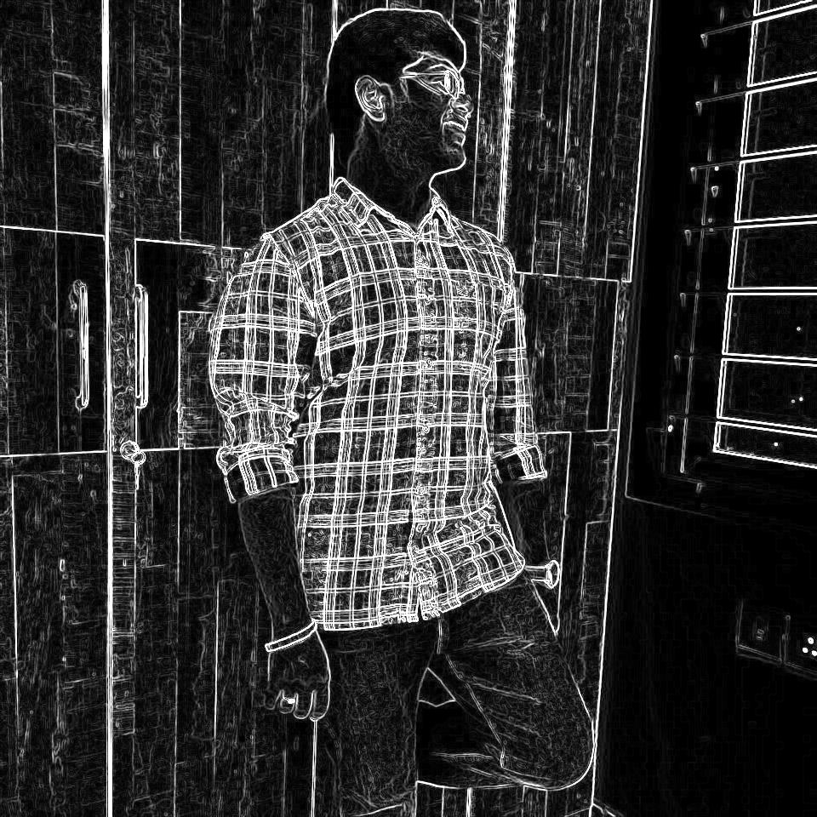
Results for gradient function
Done using “imgradient” in matlab which uses Sobel Operator as default.

Slide 11
Seam Carving Applications
Aspect Ratio Change
Object Removal
Image Enlarging
Content Amplification

Slide 12
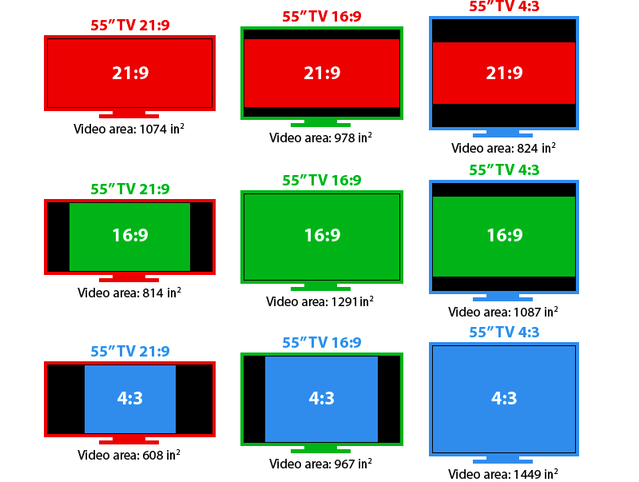
Aspect Ratio Change
Our main goal is to make a photo / Image be able to display on any screen irrespective of their Aspect Ratio . One of the most popular method is LetterBoxing.If we want to use the whole screen then we must resize the image .There might be chances of loss of information by resizing using some methods.Therefore we use Seam Carving (Content Aware Image Resizing Algo ) .

Slide 13


Results for aspect ratio change
Given an 3:2 image we must convert into 21:9 aspect ratio . We can see that the boat gets stretched when used normal resize but stretching won’t happen in Seam Carving.
The top most image is 3:2 and the below are 21:9 . Left Image is using scaling and right is done by Seam Carving

Slide 14
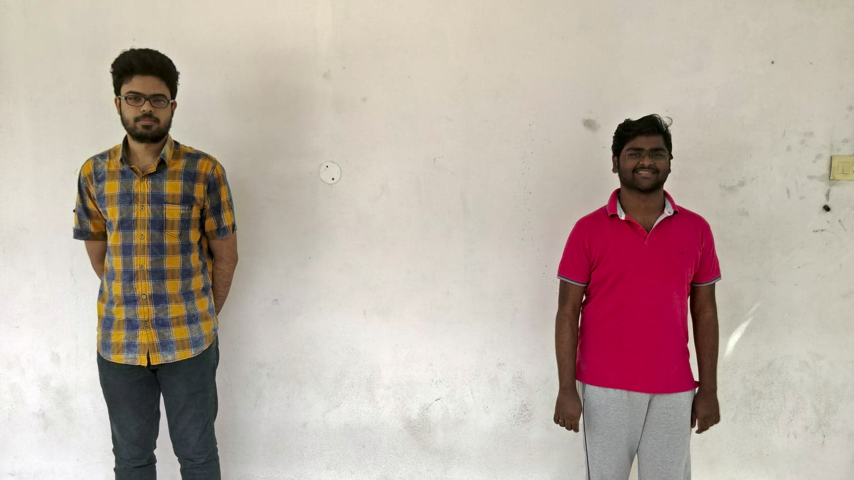
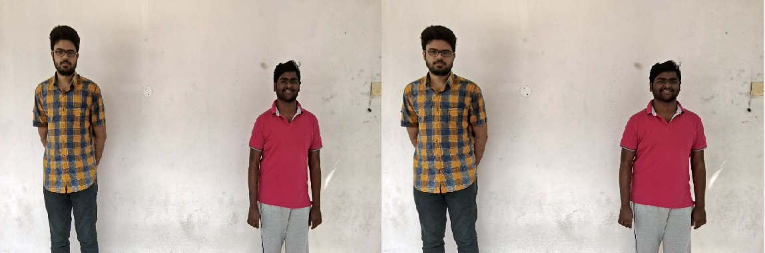
16:9 is converted to 3:2
We can see distortion /Compression in the left bottom Image(Scaling) and there is no distortion in right image(SeamCarving).

Slide 15
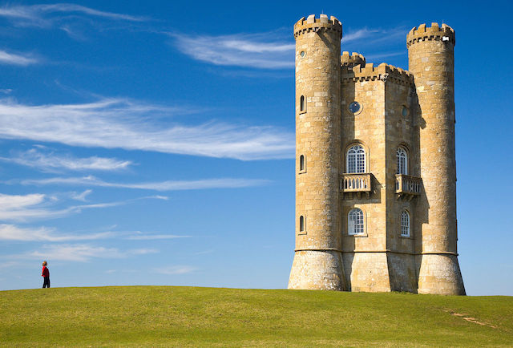
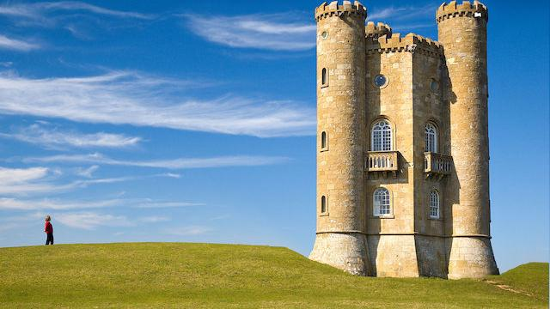
16:9
3:2

Slide 16
Object Removal
Generate the energy map using gradient method.
Find the cumulative energy map of the image Provide the minimum(-ve value) energy values to the M(I,j) if (I,j) is a selected pixel by the user
For each Iteration:
Detect the optimal seam(in the desired direction-horizontal, vertical)
Remove the Seam from the image thereby reducing a part of the selected image.

Slide 17
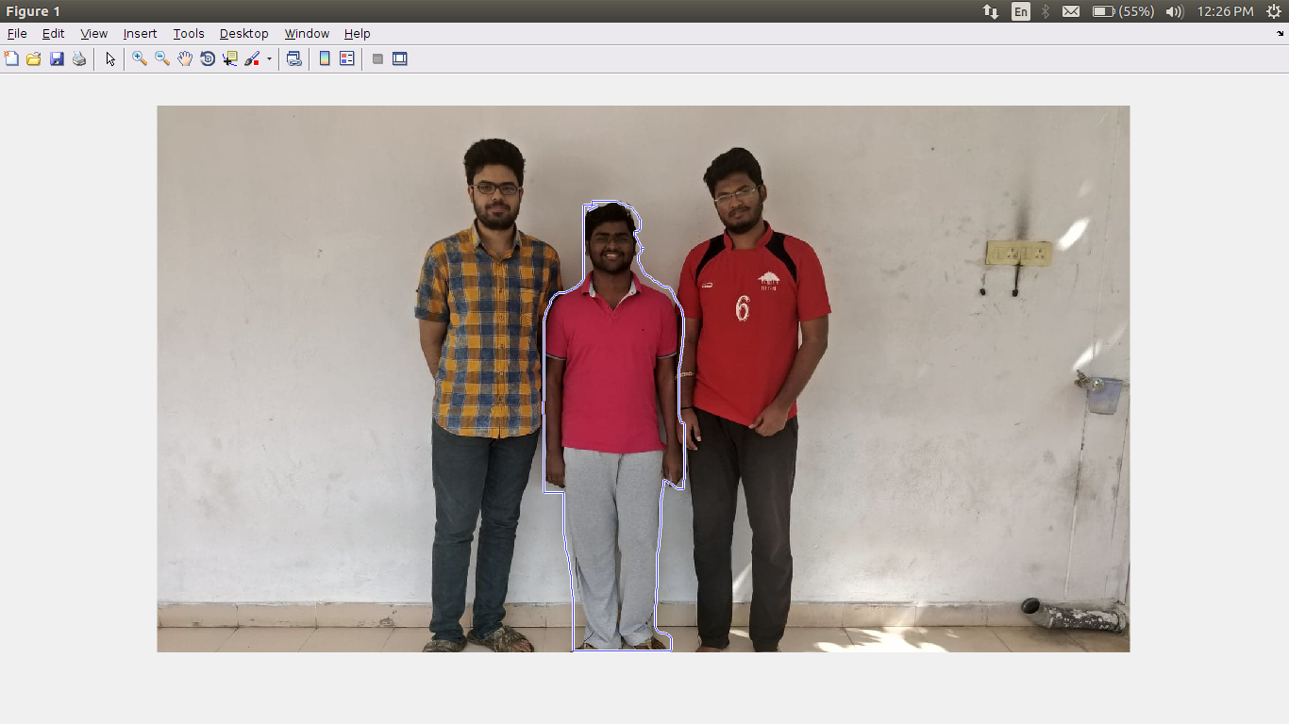
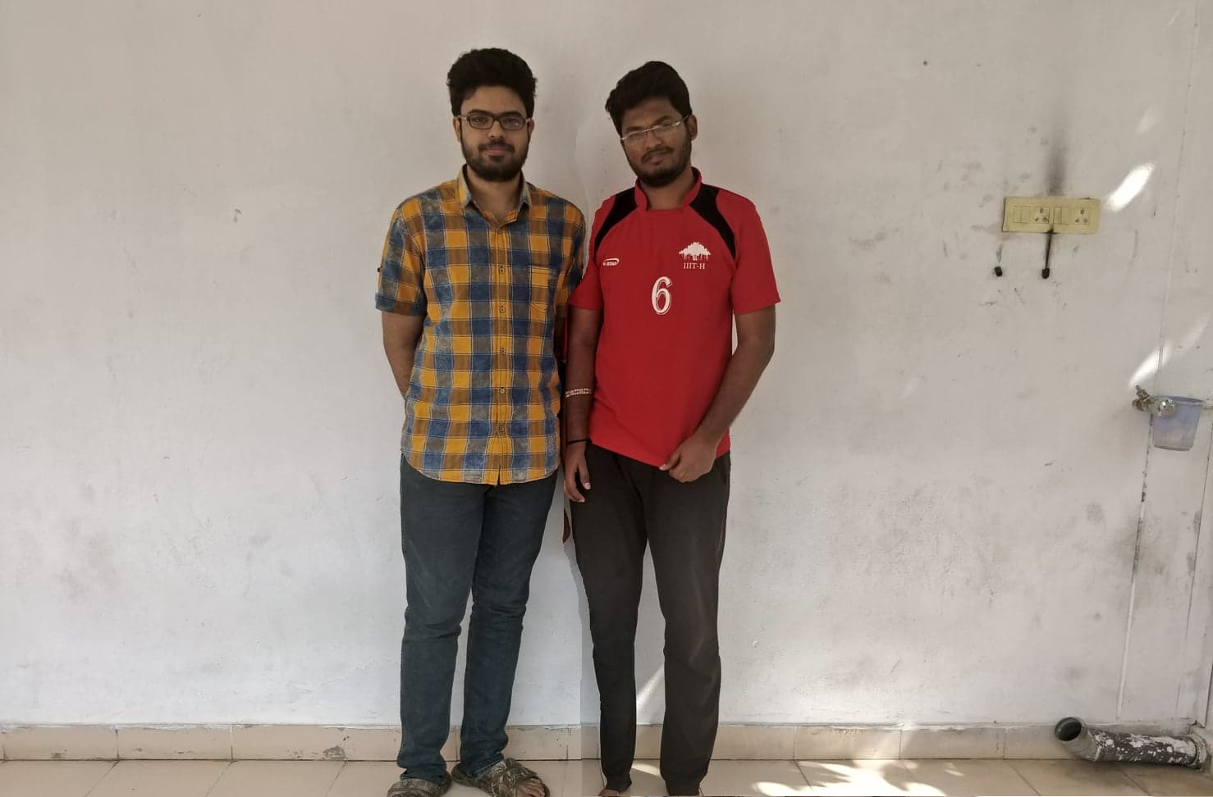
Results for object removal
We select an object to remove from the image and then we create a mask so that the pixels in the mask will be given less energy value so that it would be selected in the seam.

Slide 18
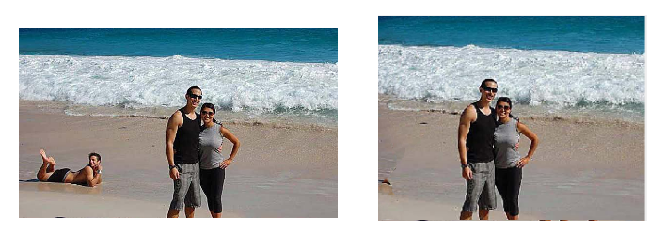

Slide 19

Object Removal Demo

Slide 20
Image enlargation
Generate the energy map using gradient method.
Find the cumulative energy map of the image
Find the least k seams and then duplicate them by either copying or averaging with the neighbouring pixels.

Slide 21
Content Amplification
If we want to see an image in a zoomed way but zooming can make the scope of vision to only near pixels i.e there two objects left and right in an image then zooming can not be done . Then we can do Content Amplification which is basically scaling and Seam Carving.

Slide 22
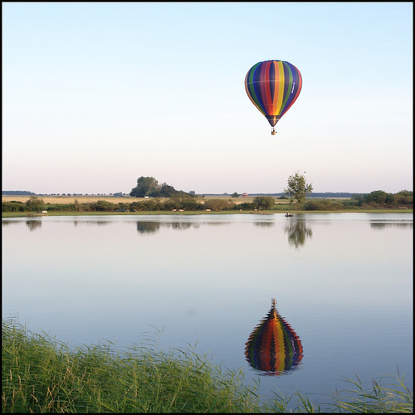
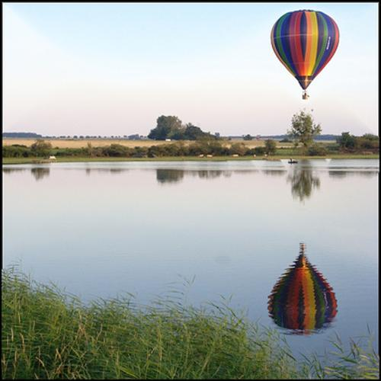
Results for content amplification

Slide 23
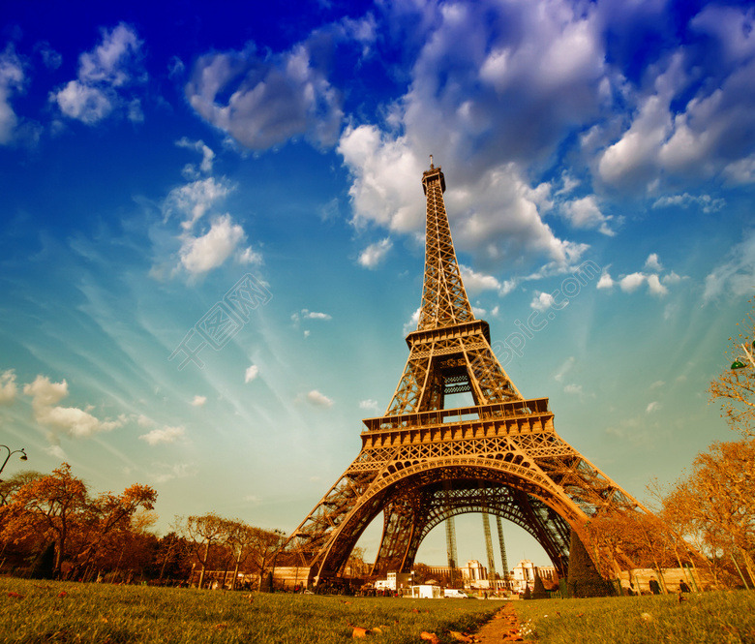
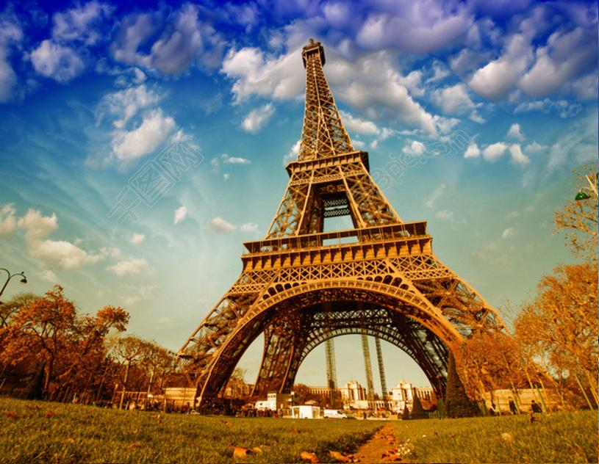

Slide 24
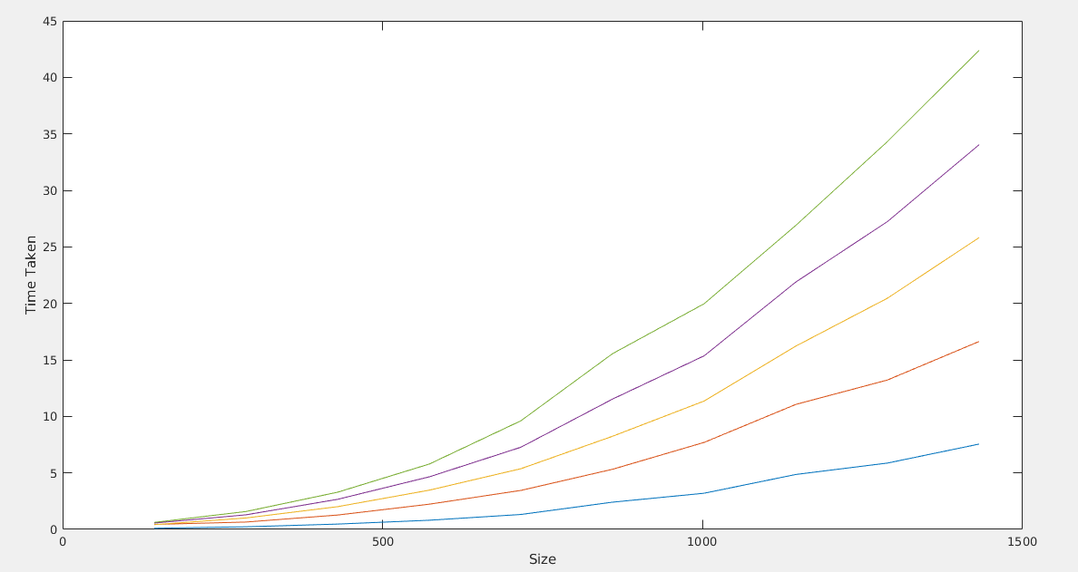
Time Graphs for Seam Carving
Below is variation of time taken to remove fixed no. of seams by varying Size of the image.Each graph is for different fixed no. of seams to room.

Slide 25
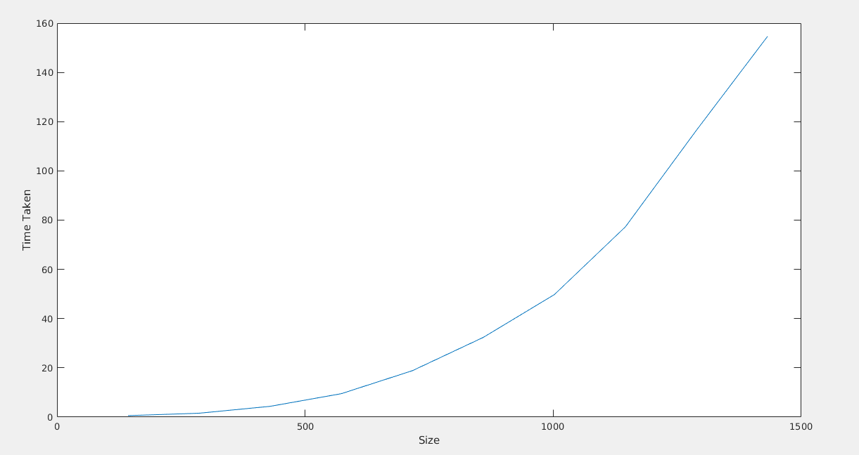
The below is the graph of time variation to resize to a fixed ratio by varying the size of an Image.
By the above graph we can infer that the graph have an exponential increase with size of Image.So if we have a large image then performing seam carving on it would be very computationally expensive.

Slide 26
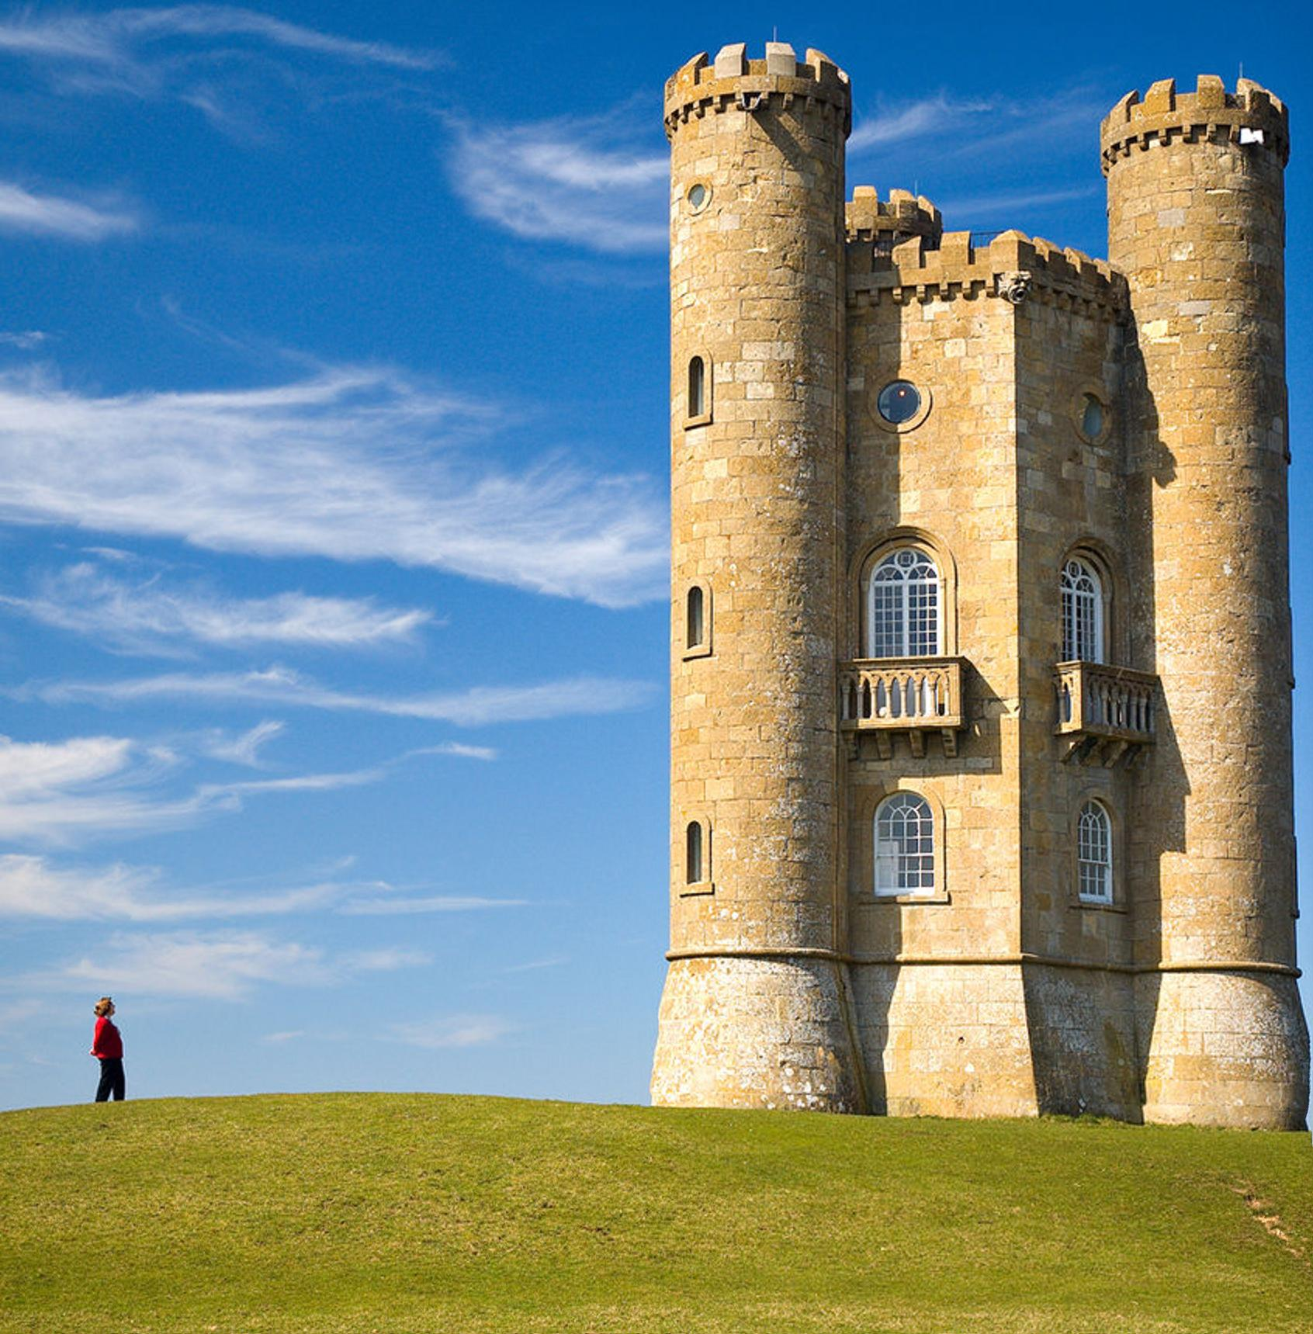
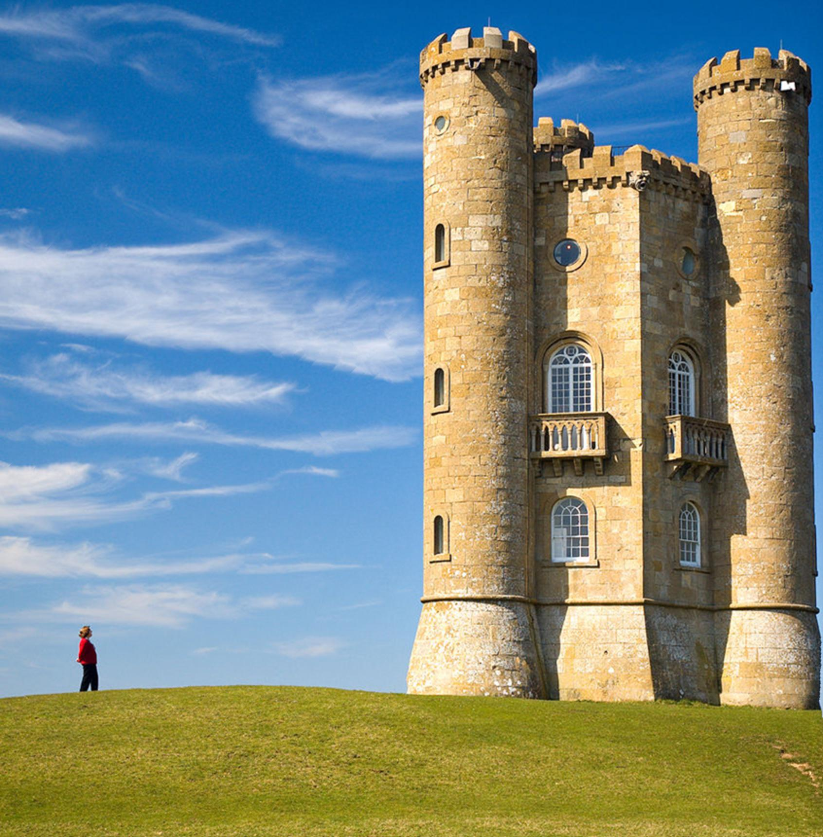
Reducing the complexity of Seam Carving.
If the image size is very large then Seam Carving on it would be computationally costly . So if we down-scale the image and perform seam Carving and revert the downscaling . For eg if we want to remove 10 seams then downscale it to 0.8 times and remove 8 seams and upscale it to 1/0.8 times i.e 10 seam removals is changed to 8 seam removals.
Default Seam Carving algo Time taken for seam Carving is 450 Sec
Scaled to 0.5 and seam carving and again scale to 2. Time taken for seam Carving is 48 Sec

Slide 27
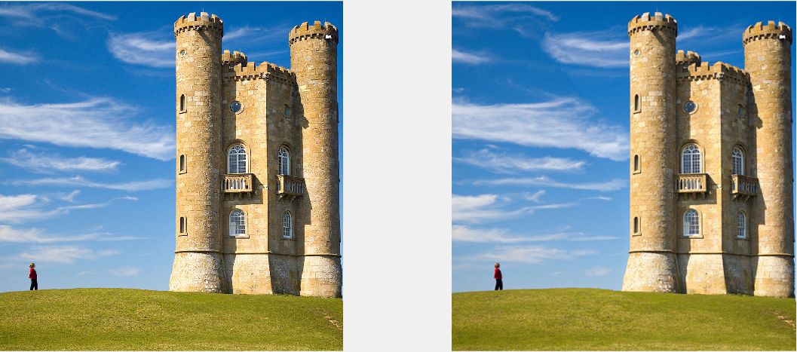
Due to the scaling in the process the clarity of the image could be decreased . The decrease in clarity is more perceivable if the size of image is less. Since we modify the algo for only very large images the decrease in clarity is not much noticed. If we use this algo for small sized image we get image like below where clarity could be decreased.
Image Size : 900 X 1200
Time for Seam Carving 46 sec
Time for Modified Seam Carving 6 sec

Slide 28
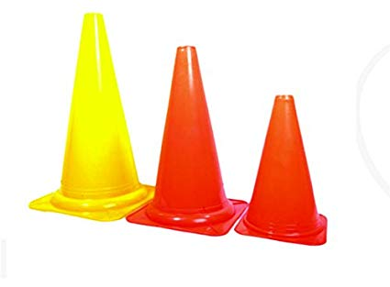
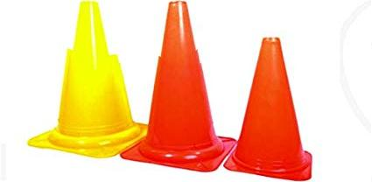
Failure Cases
Seam Carving on Geometric Structures
Here if we observe the output the cone structure is distorted.This is mainly due to the seam doesn’t look at the cone as an important feature so removal could lead to loss of cone slantness.

Slide 29
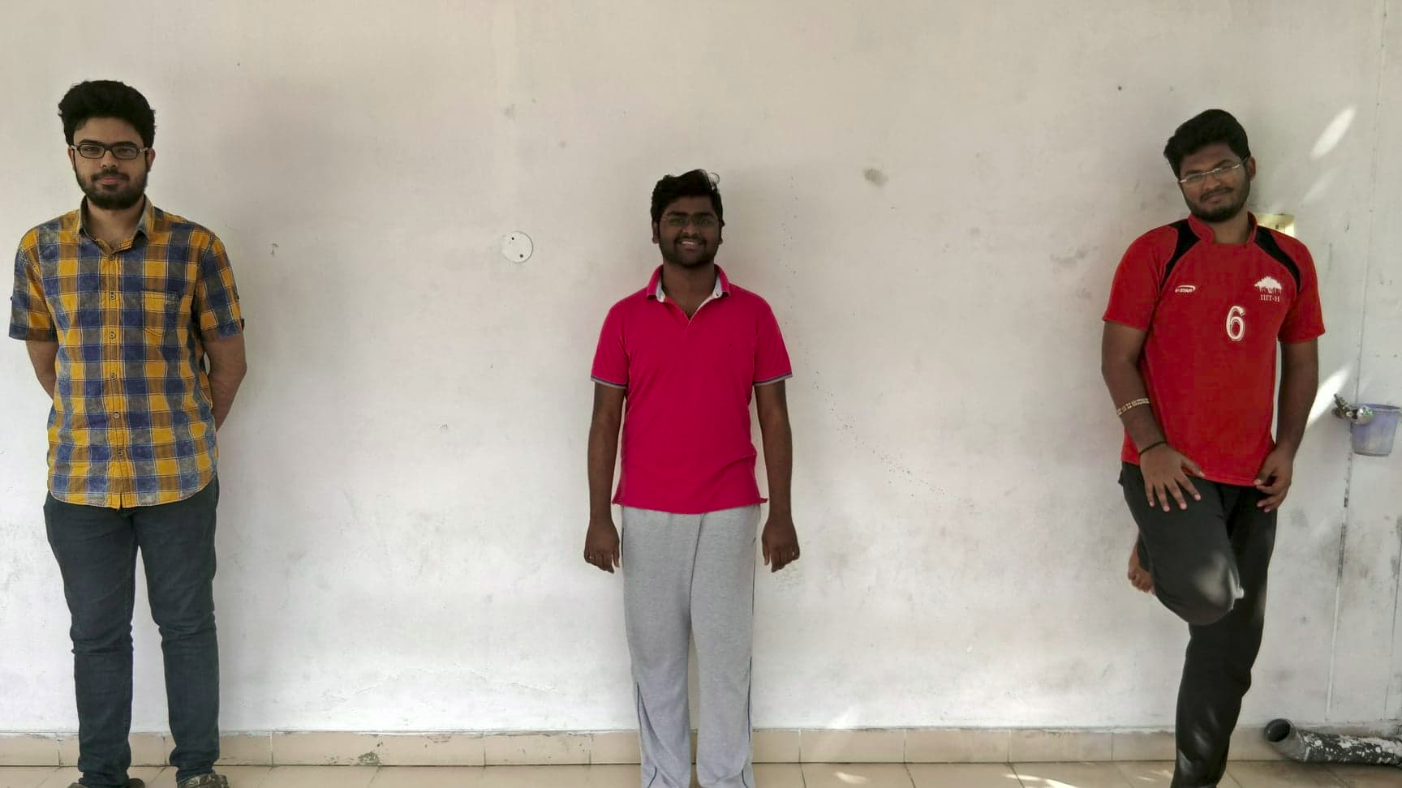
Failure while seam removal containing different types of objects
Different patterns on object
When resizing a photo consisting of objects with varying textures like the below image of me with two of my friends.There abhilash(leftmost person) wore a grid type of shirt whereas sandeep(middle person) wore a plain T-Shirt and the rightmost person wore a shirt which is not completely plain . So the chances of seam going through our shirts will be
Leftmost(Patterns) < RightMost(Not completely plain) < Middle ( completely plain)

Slide 30
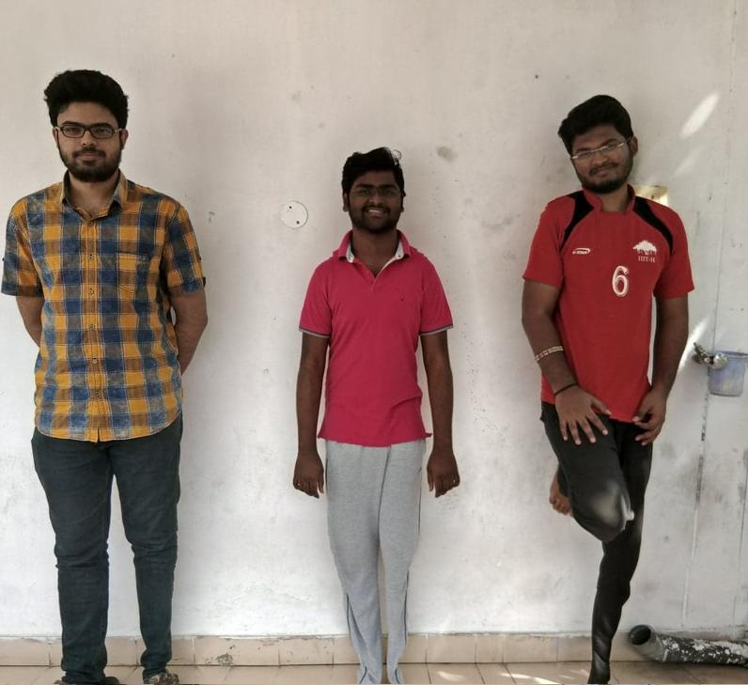
Here we can see that the middle person got more slim compared to the leftmost and rightmost person and the rightmost person also got slim compared to leftmost person . Due to the Grid pattern in leftmost person he didn’t got slim :p .

Slide 31
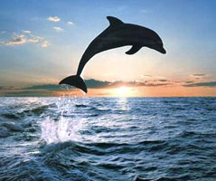
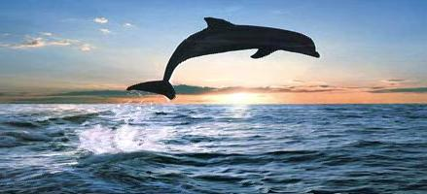
High Elongation using Seam Carving(Failure Case)
Elongation in seam carving includes finding the least optimal seams and duplicating it. If we want to elongate more then we have to select more no. of seams then dolphin could be there in the seams . So it gets distorted. Below is result if elongated by 1.5 times.

Slide 32
Solution (Idea) for Elongation Problem
The failure case of elongating to more extent is seen before .
Desired L X L ---->1.5 L X 1.5 L
Why do it one step ?
1) L X L ----> 1.2 L X 1.2 L
2) 1.2 L X 1.2 L ----> 1.5L X 1.5 L
We can rectify this problem by having a threshold in the elongation length(Ratio). Whenever desired elongation is more than threshold then elongate it to threshold and do elongation for the remaining part .

Slide 33
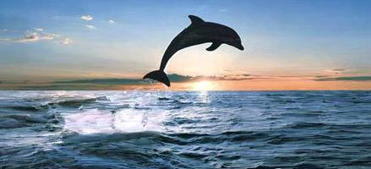
Lets say the initial length is L and we want to increase the length to say 1.5 times then half of the images will be selected in the seams and so that dolphin gets included . Instead of that if we do increase it to 1.25 L first time and 1.5 L second time then dolphin maynot get included in the seams.Therefore instead of inserting the seams in one go maintain a threshold value . Do it multiple number of times until we reach the desired size.

Slide 34
Future Direction
Rectifying Distortion in Geometric Structures
In the above failure cases , one of the failure case is distortion of cone structure . We may modify the algo in such a way that whenever we select a pixel in a line(the slant ‘/’ in cone structure) then we must make sure that pixels in a certain radius of the previous point are not taken into the seam.Like
If this pixel is taken then pixels around it should not be taken in seams

